Slide 1
EEG Variables
Course Instructor
Dr. Annushree Bablani
Acknowledgments: Dr. Sreeja S R

Slide 2
EEG
Electroencephalogram (EEG) signals are useful for diagnosing various mental conditions such as epilepsy, memory impairments and sleep disorders.
EEGs can indicate the general conscious state of a person, e.g., asleep, awake, anaesthetized, since each state is correlated with particular EEG patterns.
A flat EEG (no electrical activity) is clinical evidence of death.

Slide 3
Why EEG?
Hardware costs are significantly lower than those of most other techniques.
EEG sensors can be used in more places than fMRI, SPECT, PET, MRS, or MEG, as these techniques require bulky and immobile equipment.
EEG has very high temporal resolution, on the order of milliseconds rather than seconds, commonly recorded at sampling rates between 250 and 2000 Hz thus a valuable tool for research and diagnosis.
EEG is relatively tolerant of subject movement, unlike most other neuro imaging techniques. There even exist methods for minimizing, and even eliminating movement artifacts in EEG data.
EEG is silent, which allows for better study of the responses to auditory stimuli.
EEG does not involve exposure to high-intensity (>1 Tesla) magnetic fields, as in some of the other techniques, especially MRI and MRS. These can cause a variety of undesirable issues with the data, and also prohibit use of these techniques with participants that have metal implants in their body, such as metal-containing pacemaker.
EEG can be used in subjects who are incapable of making a motor response.
EEG is a powerful tool for tracking brain changes during different phases of life. EEG sleep analysis can indicate significant aspects of the timing of brain development, including evaluating adolescent brain maturation.

Slide 4
EEG Disadvantages
Low spatial resolution on the scalp. fMRI, for example, can directly display areas of the brain that are active, while EEG requires intense interpretation just to hypothesize what areas are activated by a particular response.
EEG poorly determines neural activity that occurs below the upper layers of the brain (the cortex).
Unlike PET and MRS, cannot identify specific locations in the brain at which various neurotransmitters, drugs, etc. can be found.
Often takes a long time to connect a subject to EEG, as it requires precise placement of dozens of electrodes around the head and the use of various gels, saline solutions, and/or pastes to keep them in place. Where as a general rule it takes considerably less time to prepare a subject for MEG, fMRI, MRS, and PET.

Slide 5
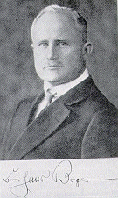
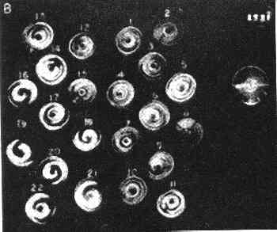
EEG Pioneers
In 1929, Hans Berger
Recorded brain activity from the closed skull
Reported brain activity changes according to the functional state of the brain
Sleep
Hypnothesis
Pathological states (epilepsy)
In 1957, Gray Walter
Makes recordings with large numbers of electrodes
Visualizes brain activity with the toposcope
Shows that brain rhythms change according to the mental task demanded

Slide 6
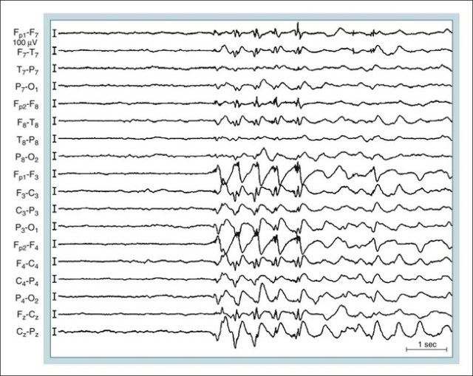
Representation of EEG channels:
The representation of the EEG channels (i.e., waveform) is referred to as a montage.
Sequential montage: Each channel represents the difference between two adjacent electrodes. The entire montage consists of a series of these channels. For example, the channel "Fp1-F3" represents the difference in voltage between the Fp1 electrode and the F3 electrode. The next channel in the montage, "F3-C3," represents the voltage difference between F3 and C3, and so on through the entire array of electrodes.

Slide 7
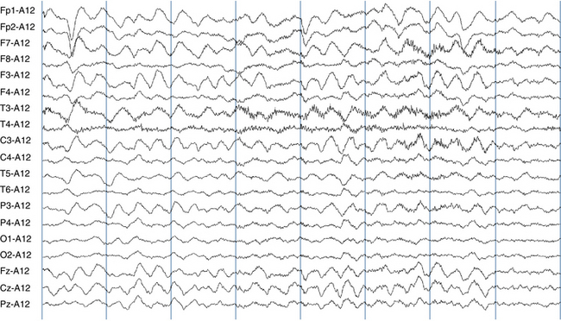
Representation of EEG channels:
Referential montage: Each channel represents the difference between a certain electrode and a designated reference electrode. There is no standard position for this reference; it is, however, at a different position than the "recording" electrodes. Midline positions are often used because they do not amplify the signal in one hemisphere vs. the other. Another popular reference is "linked ears," which is a physical or mathematical average of electrodes attached to both earlobes or mastoids.

Slide 8
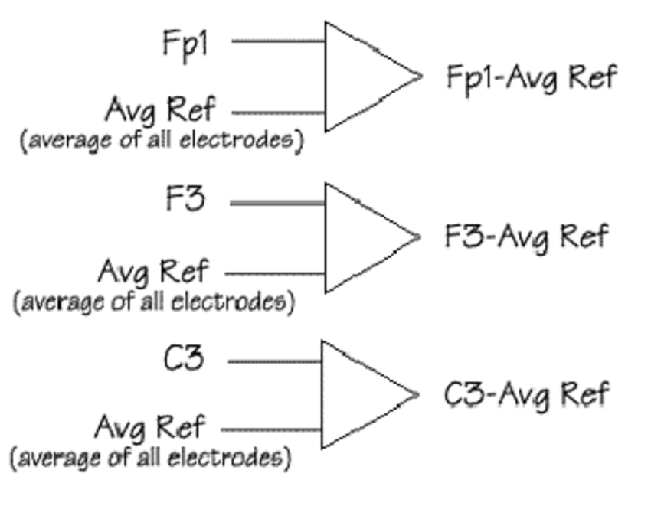
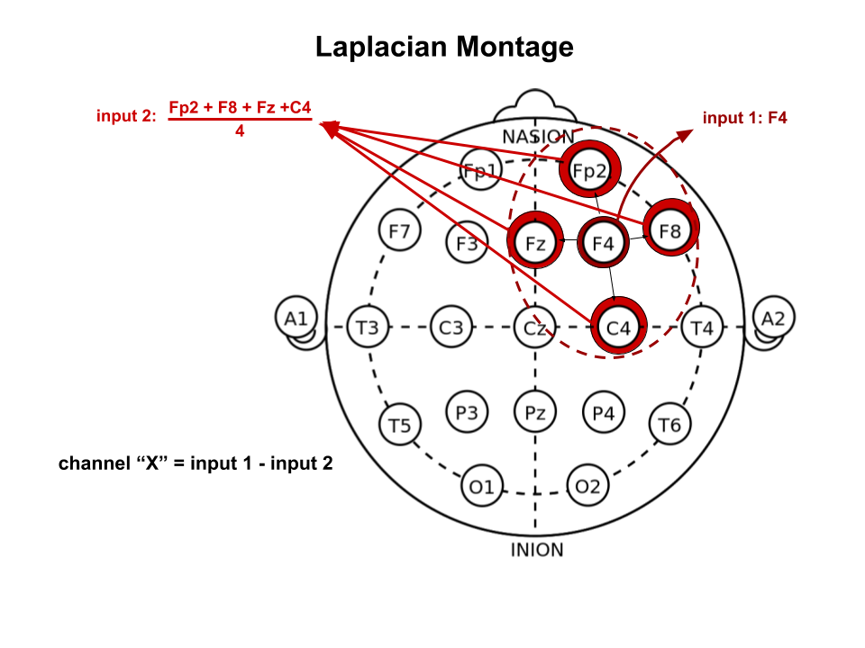
Representation of EEG channels:
Average reference montage: The outputs of all of the amplifiers are summed and averaged, and this averaged signal is used as the common reference for each channel.
Laplacian montage: Each channel represents the difference between an electrode and a weighted average of the surrounding electrodes.

Slide 9
EEG Rhythms
Generally grouped by frequency: (amplitudes are about 100µV max)
Type | Frequency | Location | Use
Delta | <4 Hz | everywhere | occur during sleep, coma
Theta | 4-7 Hz | temporal and parietal | correlated with emotional stress (frustration & disappointment)
Alpha | 8-15 Hz | occipital and parietal | reduce amplitude with sensory stimulation or mental imagery
Beta | 16-30 Hz | parietal and frontal | can increase amplitude during intense mental activity
Gamma | >30 Hz | Somatosensory cortex | A decrease in gamma-band activity is associated with cognitive decline
Mu | 8-12 Hz | frontal (motor cortex) | diminishes with movement or intention of movement
Lambda | sharp, jagged | occipital | correlated with visual attention
Vertex |  |  | higher incidence in patients with epilepsy or encephalopathy

Slide 10
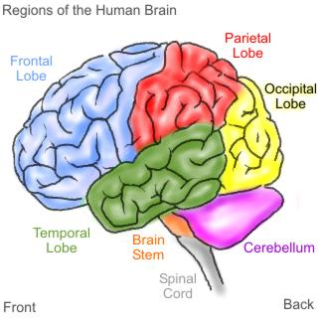

Alpha Rhythm
Frequency: 8 – 15 Hz
Amplitude: 5 – 100 microVolt
Location: Occipital, Parietal
State of Mind: Alert Restfulness
Source: Oscillating thalamic pacemaker neurons
Alpha blockade occurs when new stimulus is processed

Slide 11

Beta Rhythm
Frequency: 16 – 30 Hz
Amplitude: 2 – 20 microVolt
Location: Frontal
State of Mind: Mental Activity
Reflects specific information processing between cortex and thalamus

Slide 12
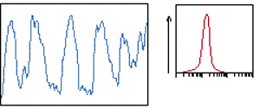
Delta Rhythm
Frequency: 1 – 4 Hz
Amplitude: 20 – 200 microVolt
Location: Variable
State of Mind: Deep sleep
Oscillations in Thalamus and deep cortical layers
Usually inibited by ARAS (Ascending Reticular Activation System)

Slide 13

Theta Rhythm
Frequency: 4 – 7 Hz
Amplitude: 5 – 100 microVolt
Location: Frontal, Temporal
State of Mind: Sleepiness

Slide 14
Mu Waves
Studied since 1930s
Found in Motor Cortex
Amplitude suppressed by Physical Movements, or intent to move physically
(Wolpaw, et al 1991) trained subjects to control the mu rhythm by visualizing motor tasks to move a cursor up and down (1D)
(Wolpaw and McFarland 2004) used a linear combination of Mu and Beta waves to control a 2D cursor.
Weights were learned from the users in real time.
Cursor moved every 50ms (20 Hz)
92% “hit rate” in average 1.9 sec

Slide 15
Alpha and Beta Waves
Studied since 1920s
Found in Parietal and Frontal Cortex
Relaxed - Alpha has high amplitude
Excited - Beta has high amplitude
So, Relaxed -> Excited
means Alpha -> Beta

Slide 16
Variables used in EEG measurement:
Frequency:
Frequency refers to rhythmic repetitive activity (in Hz). The frequency of EEG activity can have different properties including:
Rhythmic. EEG activity consisting in waves of approximately constant frequency.
Arrhythmic. EEG activity in which no stable rhythms are present.
Dysrhythmic. Rhythms and/or patterns of EEG activity that characteristically appear in patient groups or rarely seen in healthy subjects.

Slide 17
Variables used in EEG measurement:
Voltage: Voltage refers to the average voltage or peak voltage of EEG activity.
Attenuation (synonyms: suppression, depression). Reduction of amplitude of EEG activity resulting from decreased voltage.
Hypersynchrony. Seen as an increase in voltage and regularity of rhythmic activity, or within the alpha, beta, or theta range. The term implies an increase in the number of neural elements contributing to the rhythm.
Paroxysmal. Activity that reaching (usually) quite high voltage and ending with an abrupt return to lower voltage activity. Though the term does not directly imply abnormality, much abnormal activity is paroxysmal.

Slide 18
Variables used in EEG measurement:
Morphology: Morphology refers to the shape of the waveform. The shape of a wave or an EEG pattern is determined by the frequencies that combine to make up the waveform and by their phase and voltage relationships. Wave patterns can be described as being:
Monomorphic. Distinct EEG activity appearing to be composed of one dominant activity
Polymorphic. Distinct EEG activity composed of multiple frequencies that combine to form a complex waveform.
Sinusoidal. Waves resembling sine waves. Monomorphic activity usually is sinusoidal.
Transient. An isolated wave or pattern that is distinctly different from background activity.
Spike: a transient with a pointed peak and duration from 20 to less than 70 msec.
Sharp wave: a transient with a pointed peak and duration of 70-200 msec.

Slide 19
Variables used in EEG measurement:
Synchrony:
Synchrony refers to the simultaneous appearance of rhythmic or morphologically distinct patterns over different regions of the head, either on the same side (unilateral) or both sides (bilateral).
Periodicity:
Periodicity refers to the distribution of patterns or elements in time (e.g., the appearance of a particular EEG activity at more or less regular intervals). The activity may be generalized, focal or lateralized.

Slide 20
Thank You!

